Slide 1


Do neotropical flycatchers exclude each other in breeding and wintering grounds?
Yasmin C. Farias¹, Nicole R. M. de Araújo¹, Rafaella D. dos Santos¹, Letícia B. de Oliveira¹ & Roberto B. Cavalcanti¹
¹Biodiversity Conservation Planning Laboratory, Department of Zoology, University of Brasilia, 70910-900, Brasília, DF

Slide 2
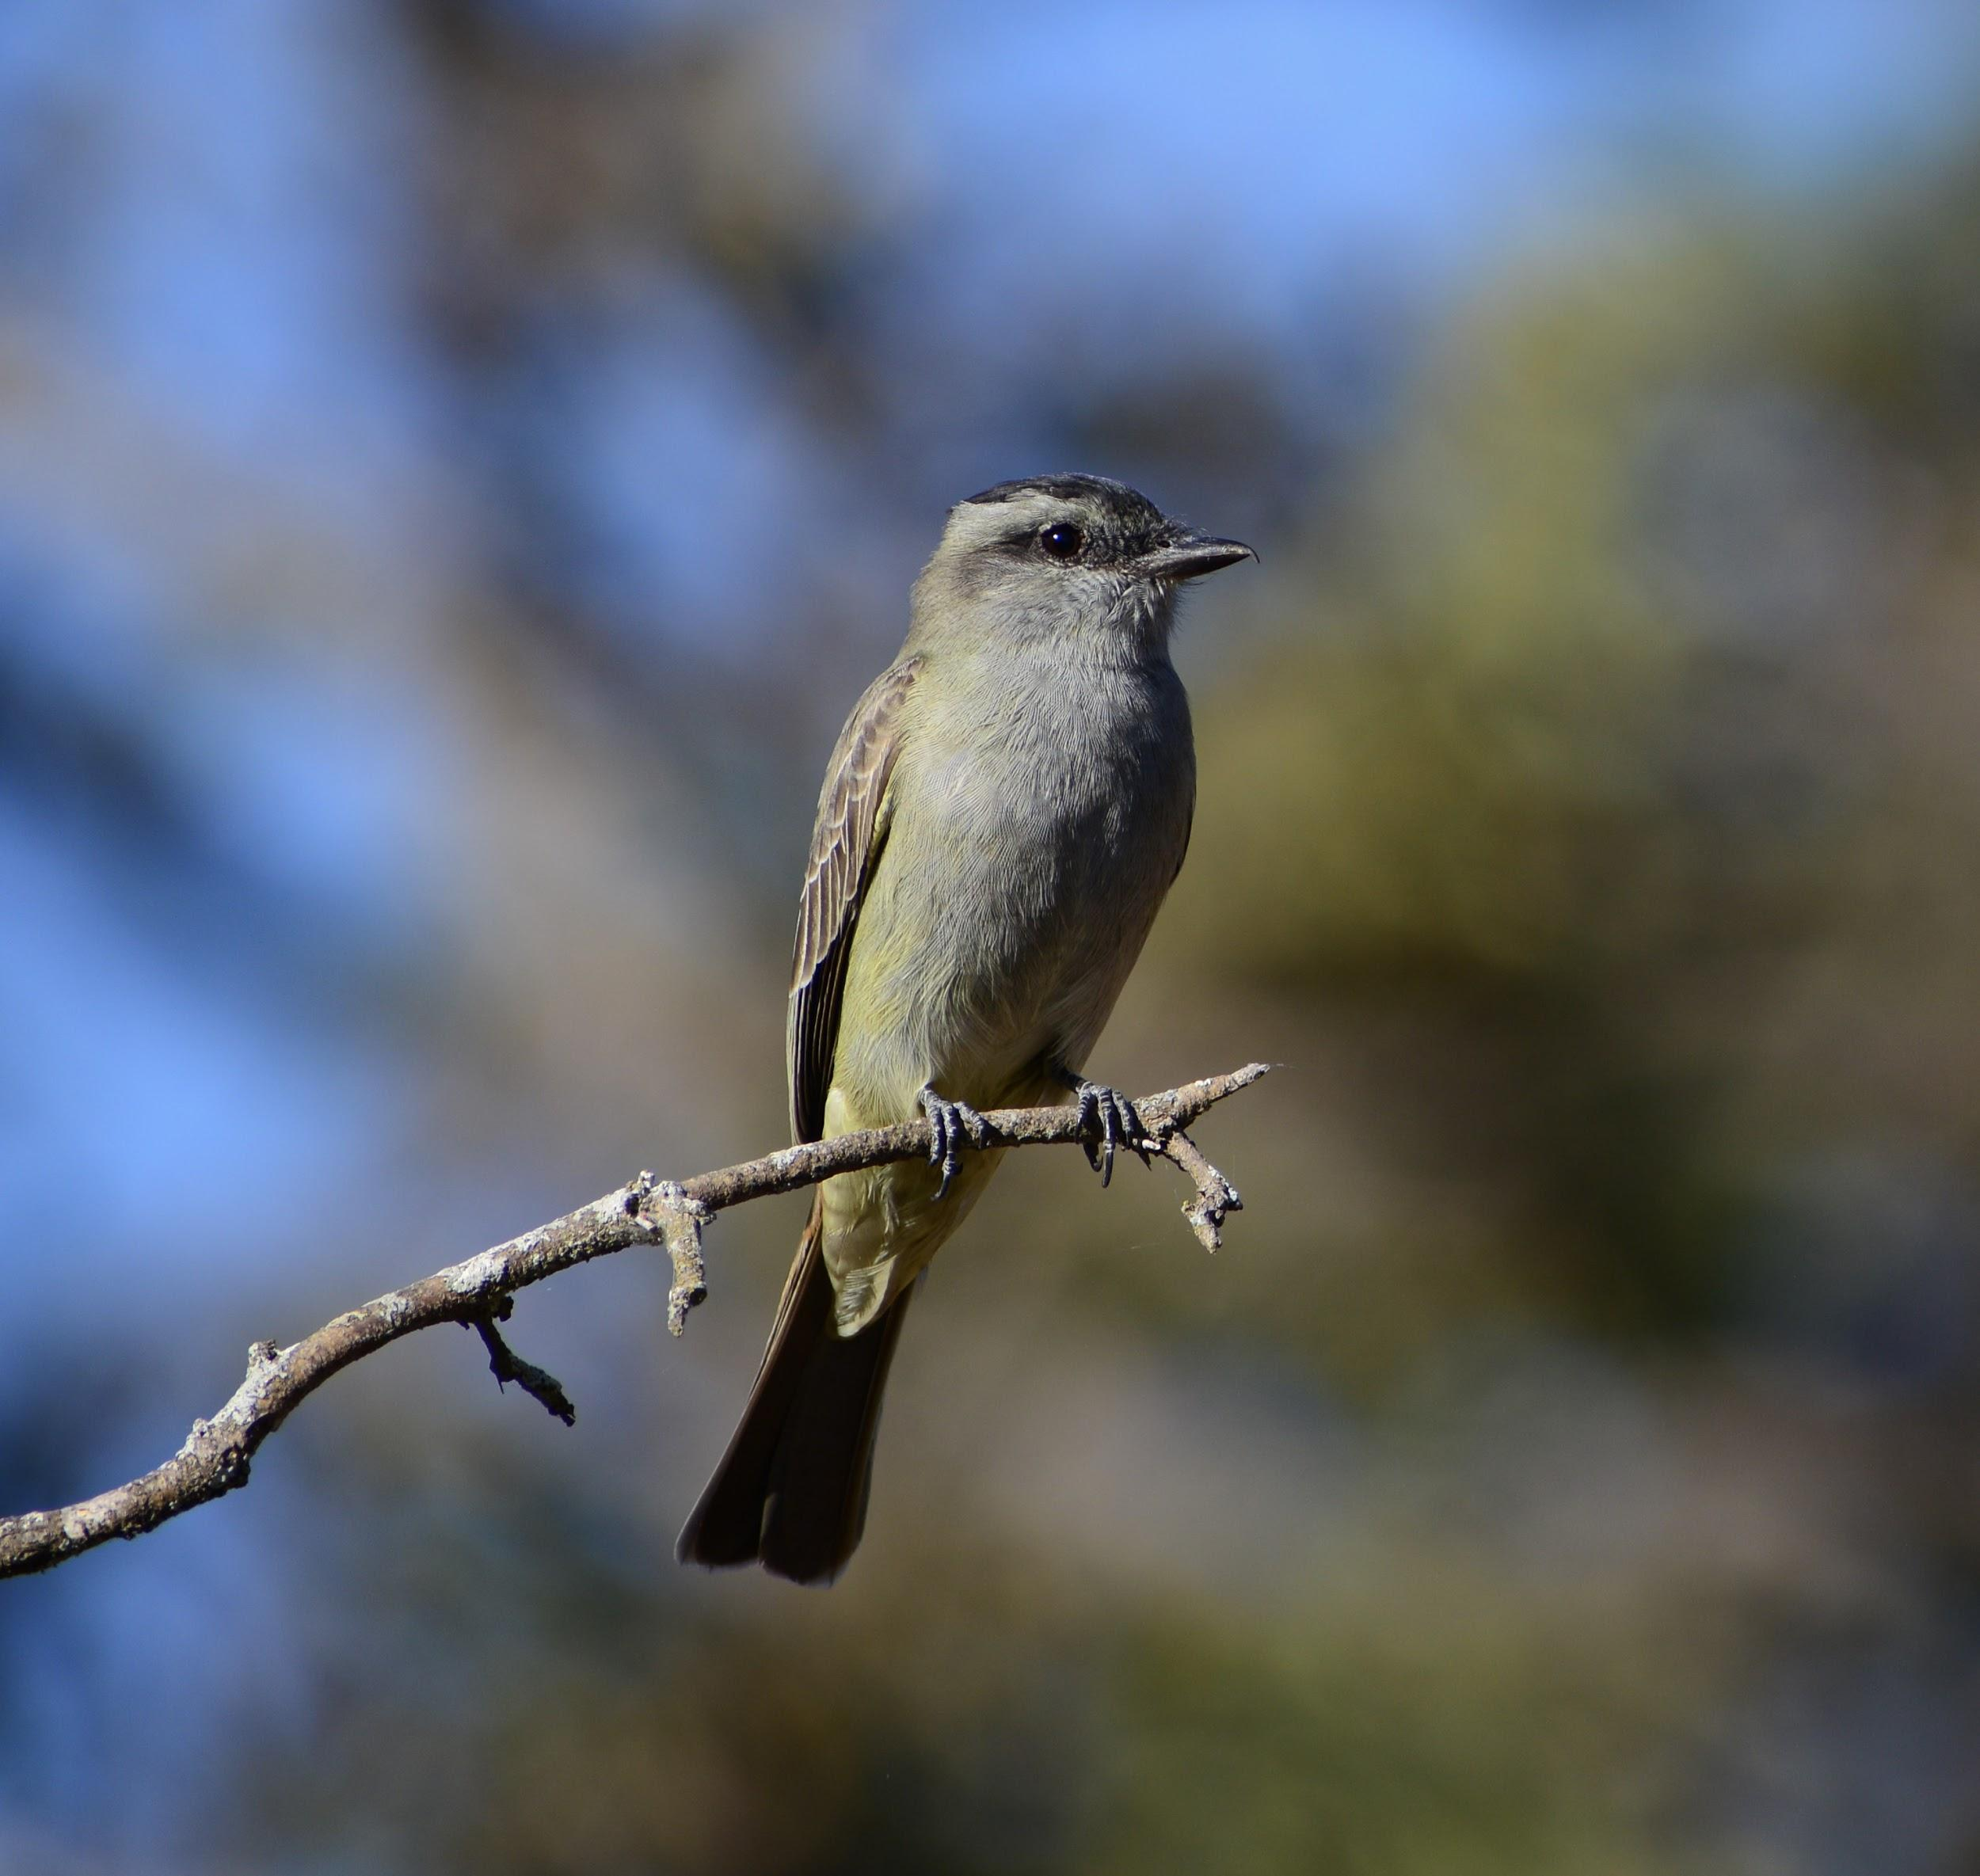
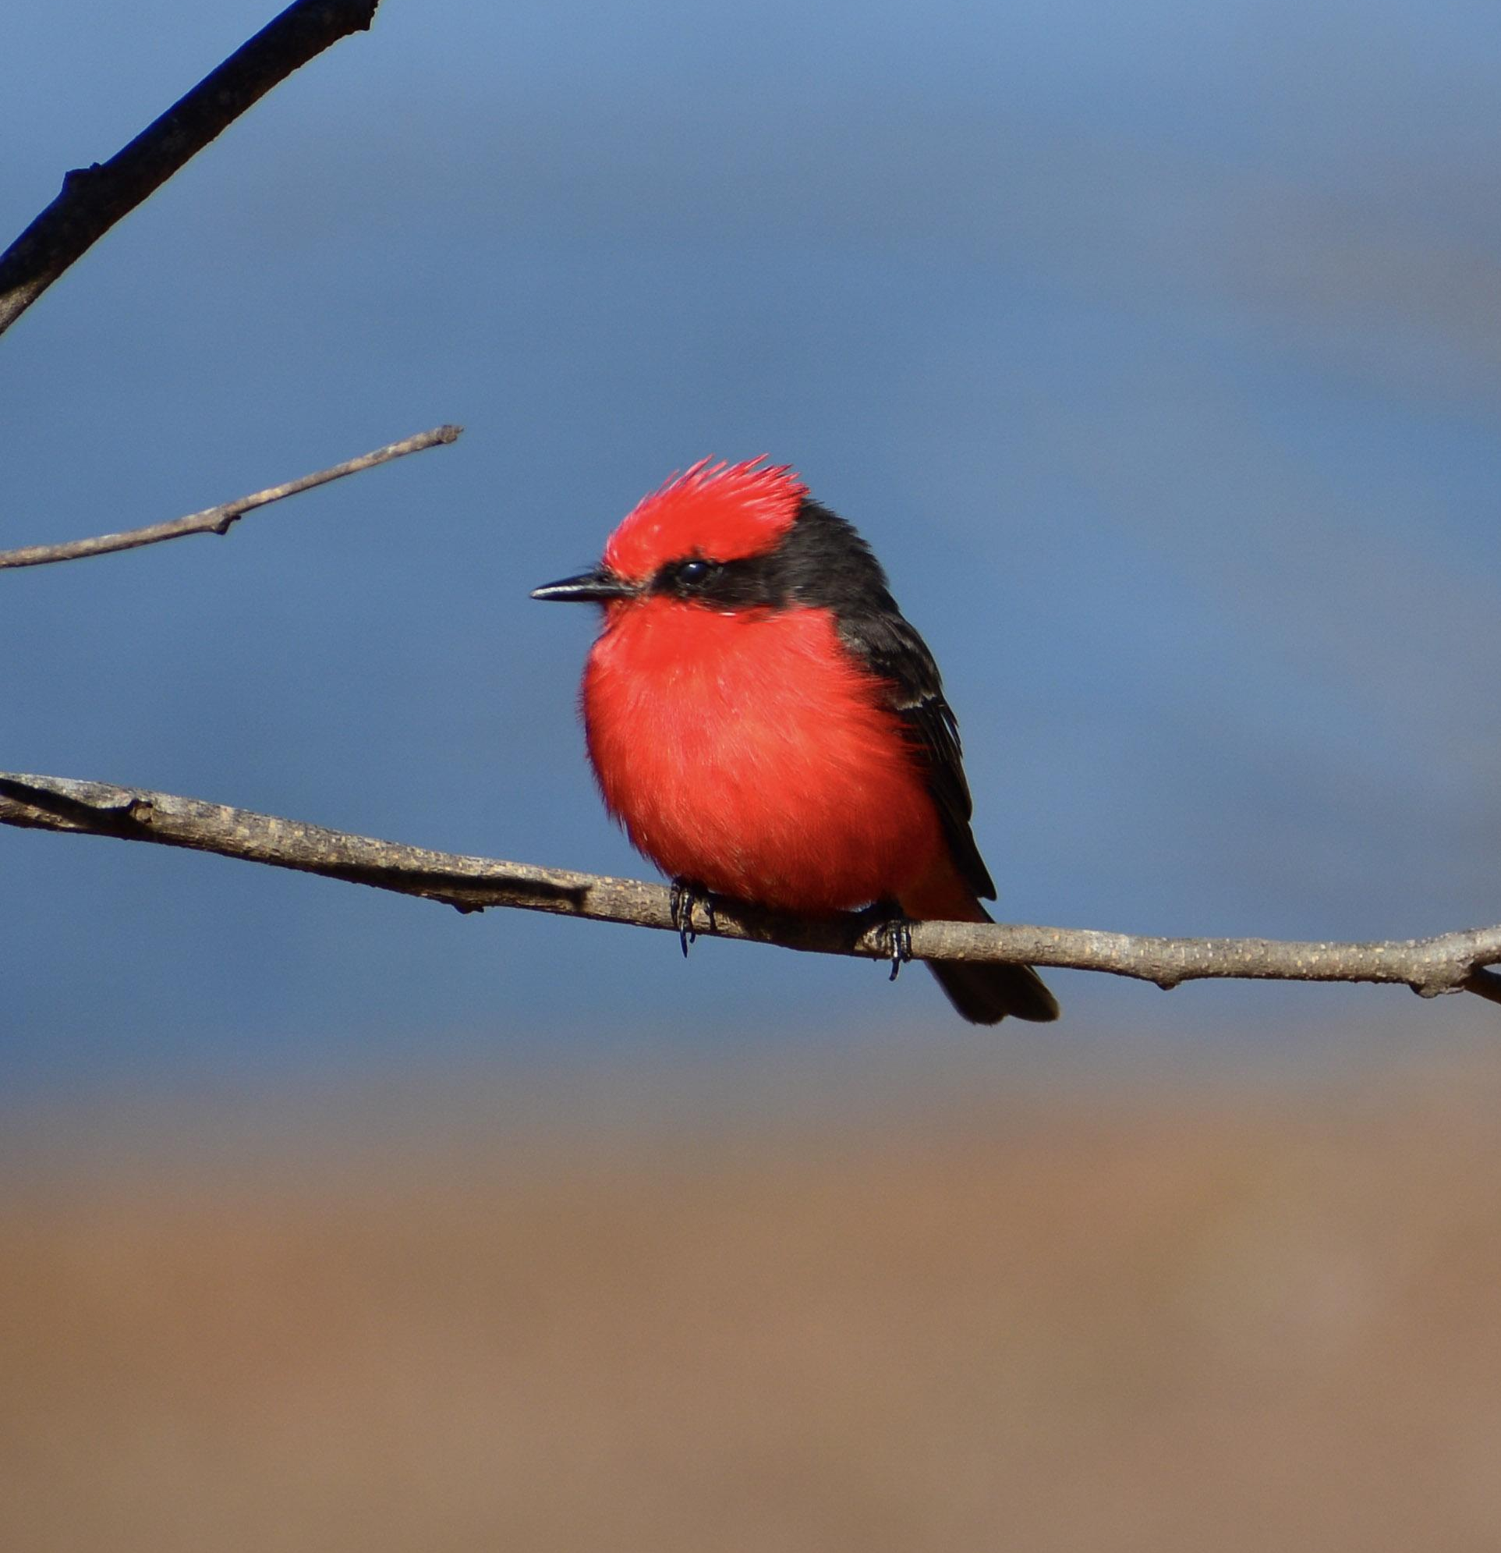
Introduction
Griseotyrannus aurantioatrocristatus
Several recent studies have highlighted the importance of migrations of flycatchers within the Neotropics, however it stills a poorly known topic;
The city of Brasília is in the core area of the Cerrado region of Central Brazil, where we find summer migrants such as the Crowned Slaty Flycatcher (Griseotyrannus aurantioatrocristatus) and winter migrants such as the Vermilion Flycatcher (Pyrocephalus rubinus).
Pyrocephalus rubinus
Photo: Roberto B. Cavalcanti
Photo: Roberto B. Cavalcanti

Slide 3
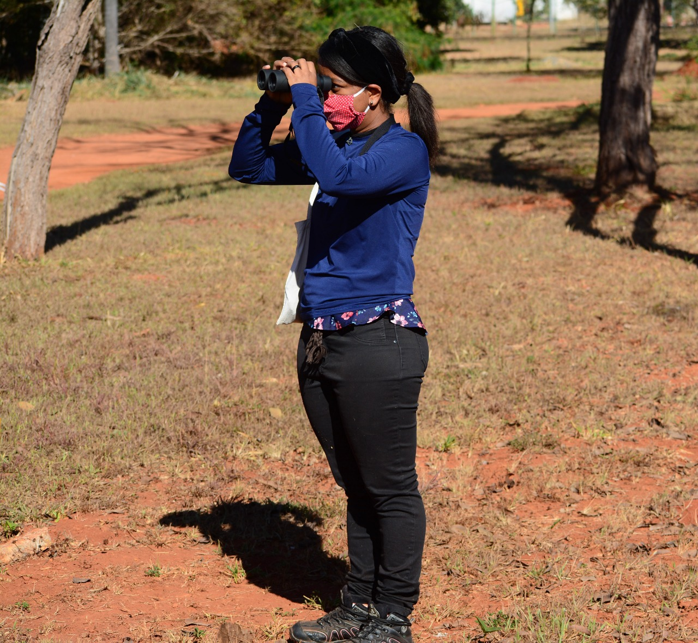
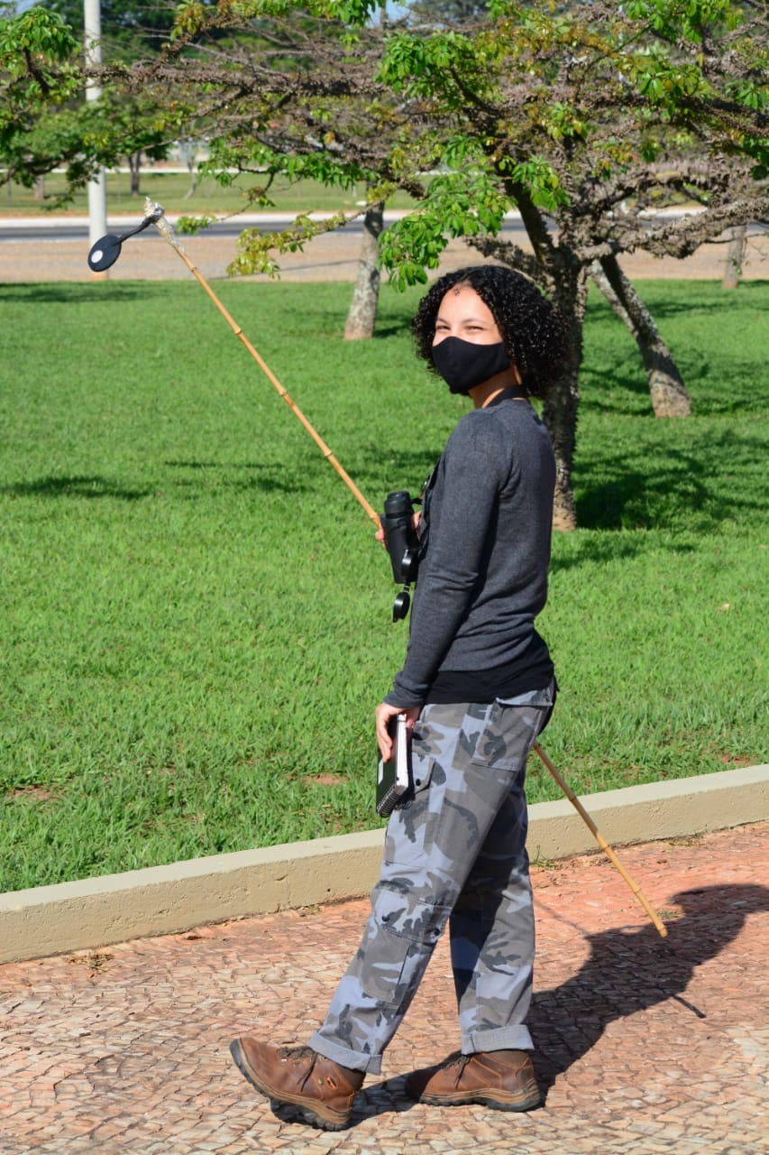
Objective(s)/Hypothesis(es)
Since 2019, we have made behavioral observations of both species;
Suggests that the summer migrant is dominant over the winter migrant;
Our objective was to investigate whether there was evidence for non-overlap in the summer and winter distributions of these species.
Photo: Roberto B. Cavalcanti
Photo: Roberto B. Cavalcanti

Slide 4

Methods
We used records from the eBird database for South America, and we separate the observations into winter months, from May to July, and into summer months, from October to February;
The data collected for the Crowned Slaty Flycatcher from November 1970 through March 2021 totals 1669 observations in winter months and 9575 in summer months;
For the Vermillion Flycatcher, the data collected from May 1969 through March 2021 totals 21691 observations in winter months and 42580 in summer months.

Slide 5



Methods
We drew on a script posted by Jeronymo Dalapicolla in GitHub to clean up the observation data in R 4.0.4, which removes duplicate observations and sampling bias;
We drew on a script posted by Hannah Owens in GitHub Gist, for a MaxEnt ensemble modeling
Lastly, we modeled potential winter and summer distributions using the Biomod2 package from R 4.0.4, and the environmental data from Worldclim version 2.1 bioclimatic variables for 1970-2000 at 2.5 arc-minutes resolution;

Slide 6
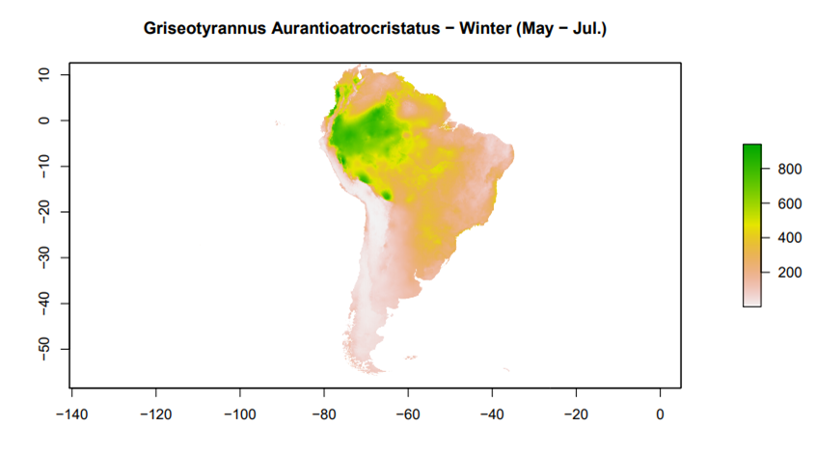
Results
Higher presence of the Crowned Slaty Flycatcher in the Amazon region.
Figure: Potential distribution of the Griseotyrannus Aurantioatrocristatus in winter. The color gradient denotes values which varies from more potential presence of the specie (dark green) to no potential presence (white).

Slide 7
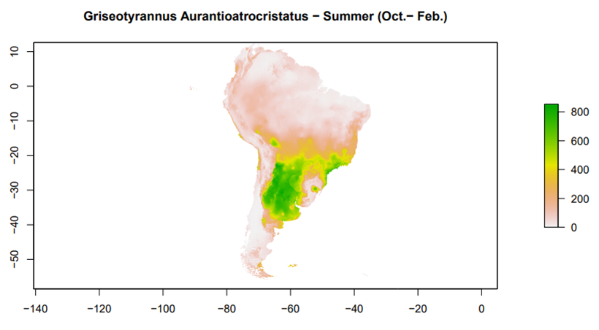
Results
More present in the western part of South America.
Figure: Potential distribution of the Griseotyrannus Aurantioatrocristatus in summer. The color gradient denotes values which varies from more potential presence of the specie (dark green) to no potential presence (white).

Slide 8
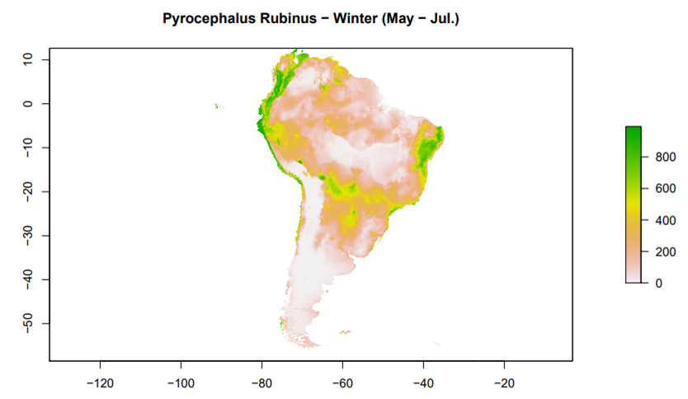
Results
More present in the western part of its range.
Figure: Potential distribution of the Pyrocephalus Rubinus in winter. The color gradient denotes values which varies from more potential presence of the specie (dark green) to no potential presence (white).

Slide 9
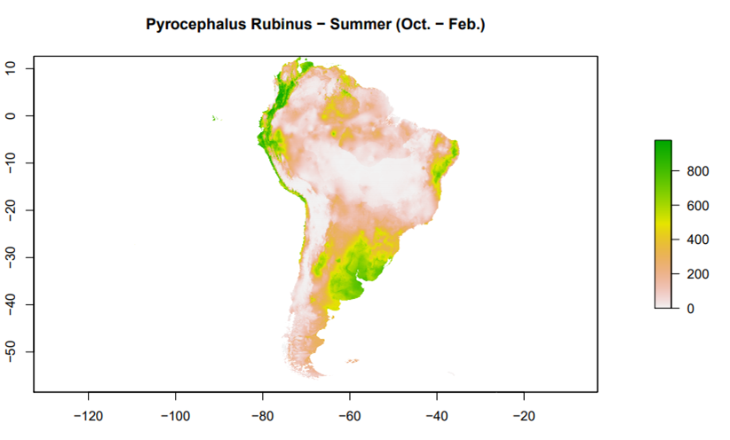
Results
More present in the eastern part of South America.
Figure: Potential distribution of the Pyrocephalus Rubinus in summer. The color gradient denotes values which varies from more potential presence of the specie (dark green) to no potential presence (white).

Slide 10
Implications/Conclusions
Our results show clear differences between the winter potential occurrence of the species;
In summer, both species have a predicted range in Southern Brazil, Argentina, Paraguay and Bolivia, but the Crowned Slaty Flycatcher is predicted to have higher preference in the western part of the range, while the Vermilion Flycatcher has a predicted non-overlapping preferred area in the eastern part of the range;
These results suggest there may be indeed distinct ranges between these flycatchers of very similar size and feeding habits.

Slide 11

References
Dalapicolla, J. (2016). Tutorial de modelos de distribuição de espécies: guia prático usando o MaxEnt e o ArcGIS 10. Vitória, ES: Laboratório de Mastozoologia e Biogeografia, Universidade Federal do Espírito Santo. Retrieved from http://blog.ufes.br/lamab/tutoriais.
Negret, A. J., & Negret, R. A. (1981). Aves Migratórias do Distrito Federal. Brasília, DF: Assessoria de relações públicas e Imprensa Setor de Áreas isoladas Norte.
Owens, H. (2016). ModelingInR. Github Gist. Retrieved from https://gist.github.com/hannahlowens/974066848f8f85554ff7.
Acknowledgments

Slide 12

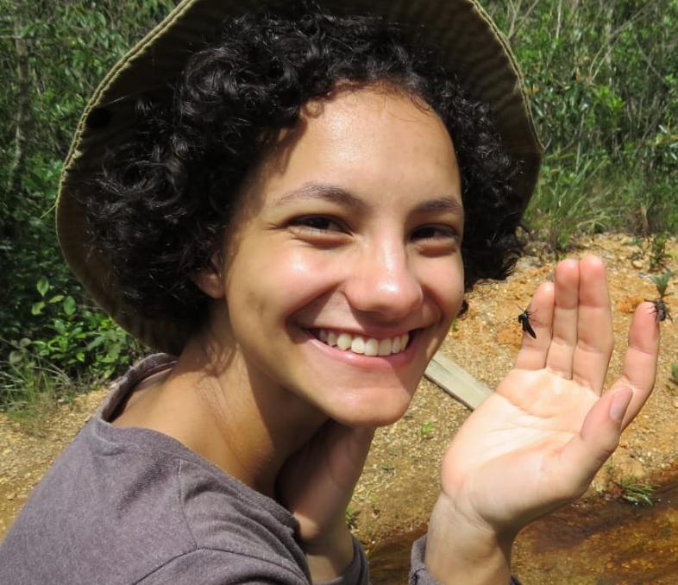



Authors
Yasmin C. Farias
Undergraduate student in biological sciences at the University of Brasília (UnB).
Nicole R. M. de Araújo
Undergraduate student in biological sciences at the University of Brasília (UnB).
Roberto B. Cavalcanti
Professor; Department of Zoology, University of Brasília (UnB).
Rafaella D. dos Santos
Undergraduate student in biological sciences at the University of Brasília (UnB).
Letícia B. de Oliveira
Undergraduate student in biotechnology at the University of Brasília (UnB)

